Slide 1
Process Synchronization
Concurrency and Race Conditions
Mutual exclusion requirements
Software and hardware solutions
Semaphores
Monitors
Classical IPC problems and solutions
Deadlock
Characterization
Detection
Recovery
Avoidance and Prevention

Slide 2
Background
Concurrent access to shared data may result in data inconsistency
Maintaining data consistency requires mechanisms to ensure the orderly execution of cooperating processes
Suppose that we wanted to provide a solution to the consumer-producer problem that fills all the buffers. We can do so by having an integer count that keeps track of the number of full buffers. Initially, count is set to 0. It is incremented by the producer after it produces a new buffer and is decremented by the consumer after it consumes a buffer.

Slide 3
Producer
while (true)
{
/* produce an item and put in nextProduced*/
while (count == BUFFER_SIZE)
; // do nothing
buffer [in] = nextProduced;
in = (in + 1) % BUFFER_SIZE;
count++;
}

Slide 4
Consumer
while (1)
{
while (count == 0)
; // do nothing
nextConsumed = buffer[out];
out = (out + 1) % BUFFER_SIZE;
count--;
/* consume the item in nextConsumed*/
}

Slide 5
Race Condition
Race condition: The situation where several processes access – and manipulate shared data concurrently. The final value of the shared data depends upon which process finishes last.
To prevent race conditions, concurrent processes must be synchronized.

Slide 6
Race Condition
count++ could be implemented as register1 = count register1 = register1 + 1 count = register1
count-- could be implemented as register2 = count register2 = register2 - 1 count = register2

Slide 7
Race Condition
If both the producer and consumer attempt to update the buffer concurrently, the assembly language statements may get interleaved.
Interleaving depends upon how the producer and consumer processes are scheduled.

Slide 8
Race Condition
Consider this execution interleaving with “count = 5” initially:
S0: producer execute register1 = count {register1 = 5} S1: producer execute register1 = register1 + 1 {register1 = 6} S2: consumer execute register2 = count {register2 = 5} S3: consumer execute register2 = register2 - 1 {register2 = 4} S4: producer execute count = register1 {count = 6 } S5: consumer execute count = register2 {count = 4}
The value of count may be either 4 or 6, where the correct result should be 5.
Reverse of s4 & S5 may give counter=6 .

Slide 9
The Critical-Section Problem
n processes all competing to use some shared data. {P₀, P₁, …, P_{n-1} }
Each process has a code segment, called critical section, in which the shared data is accessed. (changing common variables, write file, update table etc.)
Problem – ensure that when one process is executing in its critical section, no other process is allowed to execute in its critical section. (mutually exclusive)

Slide 10
Solution to Critical-Section Problem: must satisfy 3 requirements
Mutual Exclusion
Progress
Bounded Waiting
1. Mutual Exclusion - If process P_{i} is executing in its critical section, then no other processes can be executing in their critical sections
2. Progress - If no process is executing in its critical section and there exist some processes that wish to enter their critical section, then the selection of the processes that will enter the critical section next cannot be postponed indefinitely

Slide 11
Solution to Critical-Section Problem: must satisfy 3 requirements
3. Bounded Waiting - A bound must exist on the number of times that other processes are allowed to enter their critical sections after a process has made a request to enter its critical section and before that request is granted
Assume that each process executes at a nonzero speed
No assumption concerning relative speed of the N processes

Slide 12
Initial Attempts to Solve Problem
Only 2 processes, P₀ and P₁
General structure of process P_{i} (other process P_{j})
do {
entry section
critical section
exit section
reminder section
} while (1);
Processes may share some common variables to synchronize their actions.

Slide 13
Algorithm 1
Shared variables:
int turn; initially turn = 0
turn - i ⇒ P_{i} can enter its critical section
Process P_{i}
do {
while (turn != i) ;
critical section
turn = j;
reminder section
} while (1);
Satisfies mutual exclusion, but not progress

Slide 14
Algorithm 2
Shared variables
boolean flag[2]; initially flag [0] = flag [1] = false.
flag [i] = true ⇒ P_{i} ready to enter its critical section
Process P_{i}
do {
flag[i] := true; while (flag[j]) ; critical section
flag [i] = false;
remainder section
} while (1);
Satisfies mutual exclusion, but not progress requirement.

Slide 15
Algorithm 3 (Peterson’s Solution)
Combined shared variables of algorithms 1 and 2.
Process P_{i}
do {
flag [i]:= true; turn = j; while (flag [j] and turn = j) ;
critical section
flag [i] = false;
remainder section
} while (1);
Meets all three requirements; solves the critical-section problem for two processes.

Slide 16
Synchronization Hardware : for Mutual Exclusion
Many systems provide hardware support for critical section code. This makes programming task easier and improve system efficiently.
Interrupt Disabling: Uniprocessors could disable interrupts (using timers)
Currently running code would execute without execute without preemption .
Generally too insufficient on multiprocessor system
OS using this not broadly scalable (time consuming)
The first solution is to disable interrupt while a process is modifying a shared variable.
Repeat
<disable interrupt>
<critical section>
<enable interrupt>
<remainder>
forever

Slide 17
Synchronization Hardware : for Mutual Exclusion
Special machine instructions
Modern machine provide special atomic (non-interruptable) hardware instructions.
Either test memory word & set value. (Test and set instructions).
Or swap contents of memory words(Swap).
If two atomic instructions are executed simultaneously(each one of different CPU), they will be executed sequentially in some arbitrary order.
Unfortunatelly for H/W designers, implementation of these atomic instructions in multiprocessor environment is hard.

Slide 18
Mutual Exclusion with Test-and-Set
critical section using lock.
do
{
acquire lock;
critical section
release lock;
remainder section
}while(TRUE);
boolean TestAndSet (boolean *lock)
{
boolean rv = *lock
*lock = TRUE;
return rv;
}

Slide 19
Mutual Exclusion with Test-and-Set
Shared data: boolean lock = false;
Process P_{i}
do {
while (TestAndSet(lock)) ;
// critical section
lock = false;
// remainder section
}
Process can enter critical section only when
lock = FALSE, if it is Test & Set lock TRUE to acquire the lock

Slide 20
Synchronization Hardware
Atomically swap two variables.
void Swap(boolean &a, boolean &b)
{
boolean temp = a;
a = b;
b = temp;
}
The instruction exchanges contents of a register with that of a memory location

Slide 21
Synchronization Hardware : for Mutual Exclusion
Shared data (initialized to false): boolean lock;
Each process has boolean variable key; initialized to true.
Process P_{i}
do {
key = true;
while (key = = true)
Swap(lock,key);
critical section
Swap(lock,key);
remainder section
}
“process can enter critical section only if lock==false & key == true.”
“lock==true and key ==false means lock is acquired.”

Slide 22
Mutual Exclusion Machine Instructions
Advantages
Applicable to any number of processes on either a single processor or multiple processors sharing main memory
It is simple and therefore easy to verify
It can be used to support multiple critical sections

Slide 23
Mutual Exclusion Machine Instructions
Disadvantages
Busy-waiting consumes processor time
Starvation is possible when a process leaves a critical section and more than one process is waiting.
Deadlock
If a low priority process has the critical region and a higher priority process needs, the higher priority process will obtain the processor to wait for the critical region

Slide 24
Semaphores
Special variable called a semaphore is used for signaling
A process is suspended until, it has received a specific signal.
Semaphore is a variable that has an integer value
May be initialized to a nonnegative number
Wait operation decrements the semaphore value
Signal operation increments semaphore value
Two standard operations modify S: wait() and signal()
can only be accessed via two indivisible (atomic) operations
wait (S)
{
while S≤ 0
do no-op; S--;
}
signal (S):
{
S++;
}

Slide 25
Semaphore :Critical Section of n Processes
Shared data:
semaphore mutex; //initially mutex = 1
Process Pi: do { wait(mutex); critical section
signal(mutex); remainder section } while (1);

Slide 26
Semaphore : as a General Synchronization Tool
Execute B in P_{j} only after A executed in P_{i}
Use semaphore flag initialized to 0, shared by both P_{i} and P_{i}
Code:
P_{i} P_{j}
 
A wait(flag)
signal(flag) B

Slide 27
Semaphore Implementation
Disadvantage of other mutual exclusion solutions is busy waiting.
One process is executing in critical section, others are waiting in loop, such semaphores are called as spinlock.
To overcome busy waiting: wait( ) and signal( ) are modified.
When process executes & finds semaphore value is not +ve , it must wait. Instead of waiting process can block itself. block( ) operation places process from busy to waiting state(blocked).
Then control is transferred to CPU scheduler, which selects another process to execute.
Process blocked should be restarted when some other process executes a signal( ) operation. The process is restarted by wakeup( ) operation.

Slide 28
Semaphore Implementation
Each semaphore is associated with waiting queue.
No two processes can execute wait( ) and signal on the same semaphore at the same time.
To avoid spinlock, define semaphore as a record.
typedef struct
{
int value;
struct process *L;
}semaphore;
If semaphore value is –ve, its magnitude=no of processes in waiting queue.

Slide 29
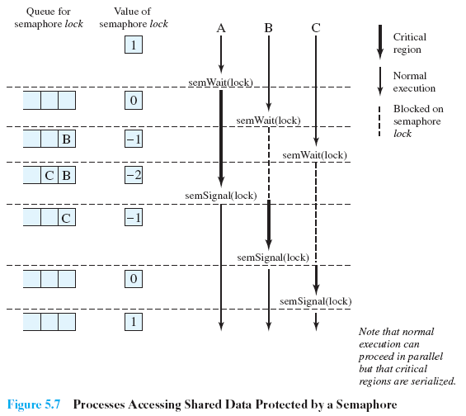
Semaphore Implementation
Processes accessing Shared Data Protected by Semaphore

Slide 30
Semaphore Implementation
Semaphore operations now defined as:
void wait(S)
{
S.value--;
if (S.value < 0)
{
add this process to S.L; block;
}
}
void signal(S)
{
S.value++;
if (S.value <= 0)
{
remove a process P from S.L; wakeup(P);
}
}

Slide 31
Semaphore as a General Synchronization Tool
Execute B in P_{j} only after A executed in P_{i}
Use semaphore flag initialized to 0
Code:
P_{i} P_{j}
 
A wait(flag)
signal(flag) B

Slide 32
Deadlock and Starvation
Deadlock – two or more processes are waiting indefinitely for an event that can be caused by only one of the waiting processes.
Let S and Q be two semaphores initialized to 1
P₀ P₁
wait(S); wait(Q);
wait(Q); wait(S);
 
signal(S); signal(Q);
signal(Q) signal(S);
Starvation – indefinite blocking. A process may never be removed from the semaphore queue in which it is suspended.

Slide 33
Two Types of Semaphores
Counting semaphore – integer value can range over an unrestricted domain.
Binary semaphore – integer value can range only between 0 and 1; can be simpler to implement.
Can implement a counting semaphore S as a binary semaphore.

Slide 34
Binary Semaphores
Srtuct binary_semaphore
{
enum{zero, one} value;
struct process *L;
};
void wait (binary_semaphore s)
{
if (s.value = = 1)
s.value = 0;
else
{
plcae this process to S.L.
block( );
}
}
void signal(binary_semaphore s)
{
if (s.queue is empty ( ) )
s.value = 1;
else
{
remove a process fro s.queue;
wakeup(p);
}
}

Slide 35
Classical Problems of Synchronization
Bounded-Buffer Problem
Readers and Writers Problem
Dining-Philosophers Problem

Slide 36
Bounded-Buffer Problem
Shared data semaphore full, empty, mutex; Initially: full = 0, empty = n, mutex = 1
Assume buffer consists of n buffers, each can hold one item.
Semaphore mutex provides Mutual Exclusion for access to the buffer pool.
Semaphore full counts number of full buffers.
Semaphore empty counts number of empty buffers.

Slide 37
Bounded-Buffer Problem
Producer Process
do {
…
produce an item in nextp
…
wait(empty);
wait(mutex);
…
add nextp to buffer
…
signal(mutex);
signal(full);
} while (1);
Consumer Process
do {
wait(full)
wait(mutex);
…
remove an item from buffer to nextc
…
signal(mutex);
signal(empty);
…
consume the item in nextc
…
} while (1);

Slide 38
Readers-Writers Problem
Two types of Processes:
Writers: modify a shared object.
Readers: they just read. They do not modify shared object.
Any number of readers may simultaneously read the file
Only one writer at a time may write to the file
If a writer is writing to the file, no reader may read it or no writer may write it.
Reader-writer problem has several variations, involving priorities:
Reader have priority: No reader will be waiting if no writer writing.(writer may suffer starvation.)
Writer have priority: if writer is writing no process can read. (reader’s starvation.)

Slide 39
Readers-Writers Problem
Shared data semaphore mutex, wrt; Initially mutex = 1, wrt = 1, readcount = 0
How many processes currently reading object.

Slide 40
Readers-Writers Problem
wrt :
Mutual exclusion for writers.
The semaphore wrt is common to both reader and writer processes.
Used by first & last reader that enter or exits critical section.
It is not used by readers who enter or exit while other readers are in their critical section.
If writer is in critical section and n readers are waiting then one reader is queued on wrt and n-1 readers queued on mutex.
When writer executes signal(wrt). We can resume execution of waiting reader or writer but decision is made by scheduler.
mutex semaphore is used to ensure mutual exclusion when variable readcount is updated.

Slide 41
Readers-Writers Problem
mutex = 1
wrt = 1
readcount = 0
The structure of a writer process
do {
wait (wrt) ;
// writing is performed
signal (wrt) ;
} while (TRUE);
Allow only one
writer at a time
to write
Notes:
‹#›

Slide 42
Readers-Writers Problem
The structure of a reader process
do {
wait (mutex) ;
readcount ++ ;
if (readcount == 1)
wait (wrt) ;
signal (mutex) ;
// reading
wait (mutex) ;
readcount - - ;
if (readcount == 0)
signal (wrt) ;
signal (mutex) ;
} while (TRUE);
mutex = 1
wrt = 1
readcount = 0
Proceed only if no writer is writing; disallow writers once we proceed
Signal a writer
only when there
are no more
active readers
Notes:
‹#›

Slide 43
The Readers/Writers Problem
Multiple readers (customers) want to read the database — access schedules, flight availability, etc.
Multiple writers (the airline) want to write the database — update the schedules
It is acceptable to have multiple readers at the same time
But while a writer is writing to (updating) the database, no one else can access the database — either to read or to write
Two versions:
Readers have priority over writers
Writers have priority over readers
In most solutions, the non-priority group can starve

Slide 44
(Using Semaphores)
Reader:
Needs mutually exclusive access while manipulating “readers” variable
Does not need mutually exclusive access while reading database
If this reader is the first reader, it has to wait if there is an active writer (which has exclusive access to the database)
First reader did a “Wait(write)”
If other readers come along while the first one is waiting, they wait at the “Wait(mutex)”
If other readers come along while the first one is actively reading the database, they can also get in to read the database
When the last reader finishes, if there are waiting writers, it must wake one up

Slide 45
(Using Semaphores)
Writer:
If there is an active writer, this writer has to wait (the active writer has exclusive access to database)
If there are active readers, this writer has to wait (readers have priority)
First reader did a “Wait(write)”
The writer only gets in to write to the database when there are no other active readers or writers
When the writer finishes, it wakes up someone (either a reader or a writer —it’s up to the CPU scheduler)
If a reader gets to go next, then once it goes through the “V(mutex)” and starts reading the database, then all other readers waiting at the top “P(mutex”) get to get in and read the database as well

Slide 46
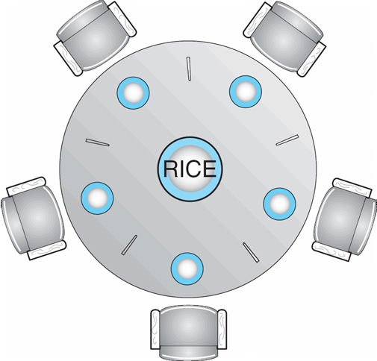
Dining-Philosophers Problem
3
4
2
0
1
Shared data
Bowl of rice (data set)
Semaphore chopstick [5] initialized to 1
Notes:
‹#›

Slide 47
Dining-Philosophers Problem (Cont.)
The structure of Philosopher i:
do {
wait ( chopstick[i] );
wait ( chopStick[ (i + 1) % 5] );
// eat
signal ( chopstick[i] );
signal (chopstick[ (i + 1) % 5] );
// think
} while (TRUE);
Deadlock? Starvation?
What happens if all pick their left chopsticks?
Notes:
‹#›

Slide 48
Problems with semaphore
Correct use of semaphore operations:
signal (mutex) …. wait (mutex)
Can violate mutual exclusion
wait (mutex) … wait (mutex)
Can lead to deadlock!
Omitting of wait (mutex) or signal (mutex)
either suffer mutual exclusion or deadlock.

Slide 49
Monitors
A higher-level abstraction that provides a convenient and effective mechanism for process synchronization
Key Idea: Only one process may be active within the monitor at a time
monitor monitor-name
{
// shared variable declarations
procedure P1 (…) { …. }
…
procedure Pn (…) {……}
Initialization code ( ….) { … }
…
}
}
Procedure defined within a monitor can access only those variables declared locally within monitor.

Slide 50
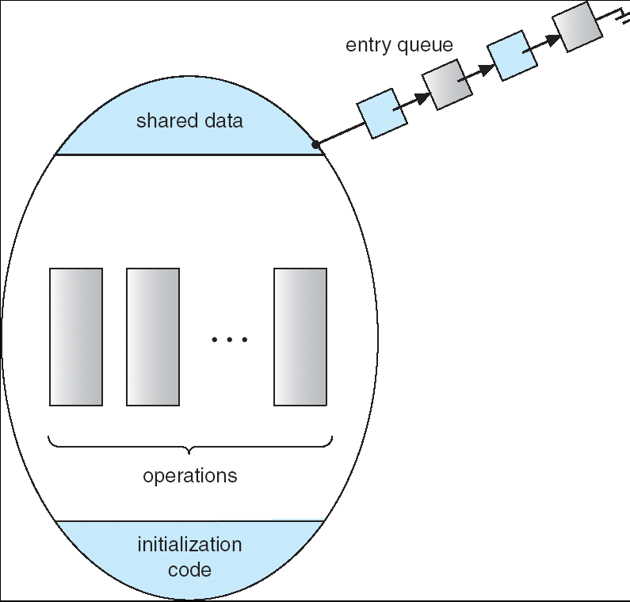
Schematic view of a Monitor

Slide 51
Condition Variables
condition x, y;
Two operations on a condition variable:
x.wait () – process invoking the operation is suspended.
x.signal () – resumes one of the processes (if any) that
invoked x.wait ()

Slide 52
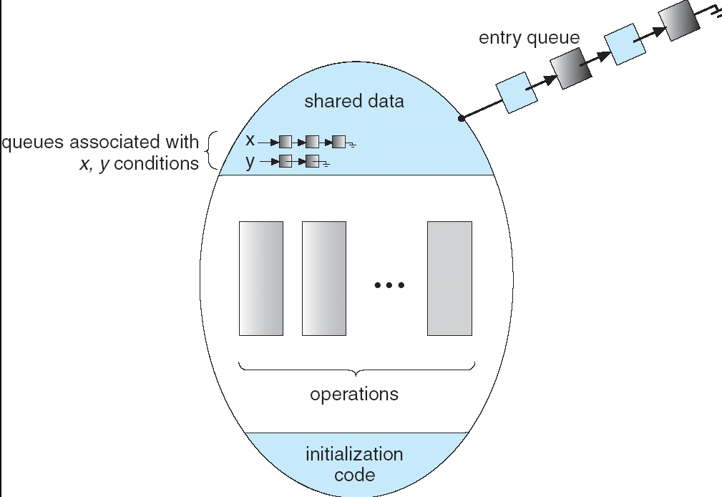
Monitor with Condition Variables
Programmers own synchronization scheme

Slide 53
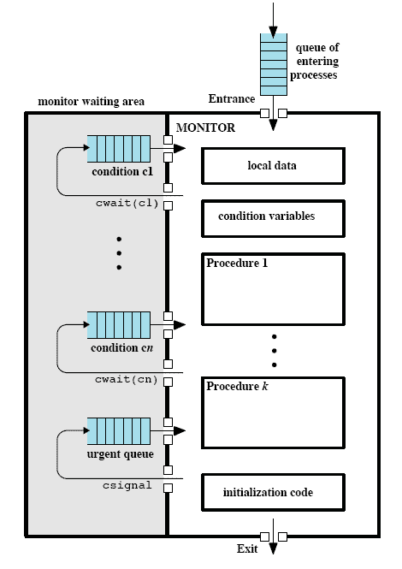
Structure of a Monitor
Notes:
Although a process can enter the monitor by invoking any of its procedures, we can think of the monitor as having a single entry point that is guarded so that only one process may be in the monitor at a time.
Other processes that attempt to enter the monitor join a queue of processes blocked waiting for monitor availability.
Once a process is in the monitor, it may temporarily block itself on condition x by issuing cwait(x);
it is then placed in a queue of processes waiting to re-enter the monitor when the condition changes, and resume execution at the point in its program following the cwait(x) call.
If a process that is executing in the monitor detects a change in the condition variable x, it issues csignal(x),
which alerts the corresponding condition queue that the condition has changed.

Slide 54
Solution to Dining Philosophers
monitor DP
{
enum { THINKING; HUNGRY, EATING} state [5] ;
condition self [5];
void pickup (int i)
{
state[i] = HUNGRY;
test(i);
if (state[i] != EATING) self [i].wait;
}
void test (int i)
{
if ( (state[(i + 4) % 5] != EATING) && (state[i] == HUNGRY)
&& (state[(i + 1) % 5] != EATING) )
{
state[i] = EATING ;
self[i].signal () ;
}
}

Slide 55
Solution to Dining Philosophers (cont)
void putdown (int i)
{
state[i] = THINKING;
// test left and right neighbors
test((i + 4) % 5);
test((i + 1) % 5);
}
initialization_code( )
{
for (int i = 0; i < 5; i++)
state[i] = THINKING;
}
}

Slide 56
Solution to Dining Philosophers (cont)
Each philosopher I invokes the operations pickup()
and putdown() in the following sequence:
dp.pickup (i)
EAT
dp.putdown (i)

